Slide 1


Student dropout analysis in school education
TECHSPERTZ
23rd September 2023
PS CODE : 1362
Team Leader : Hitesha Sahani
Institute Code : U0890
BENNETT UNIVERSITY

Slide 2
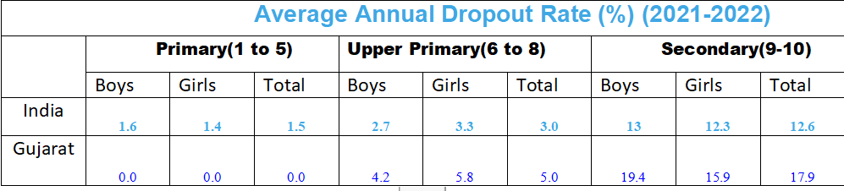
1) Empowering Students: Our "DropoutFreeIndia.org" initiative provides students with the mentorship, tools, and resources they need to complete their high school, excel, and innovate. 2) Government Support: Backed by the Government of Gujarat, this initiative carries the weight of official endorsement and resources, signaling a commitment to transforming education. 3) A Revolution in Education: This is more than just a program; it's a revolution in education, breaking down barriers and reshaping the future, where every student's potential is celebrated and realized.
Problem Statement
Technology Stack
High school dropout rates in India are a major concern. It limits opportunities for education and career growth, leading to inadequate skills and higher dropout rates.
FRONTEND
BACKEND
DEVELOPER
TOOLS
1) HTML 5
2) CSS 3
3) JAVA SCRIPT
1) JAVA SCRIPT
1) VS CODE
2) REPLIT
Data Collection
1) The dropout rate is highest at the secondary level (9-10) with 12.6 percent, followed by upper primary (6-8) with 3 percent and primary (1-5) with 1.5.
2) The data further reveals that the dropout rate is higher for girls than boys at all levels of education.
3) The rate is slightly higher for upper primary students (Classes 6-8), with an average of 3 percent.
Show- Stoppers
Girl dropout rates: primary school - 1.4%, upper primary - 3.3%, secondary school - 12.3%. Boy dropout rates: primary school - 1.6%, upper primary - 2.7%, secondary school - 13%.

Slide 3
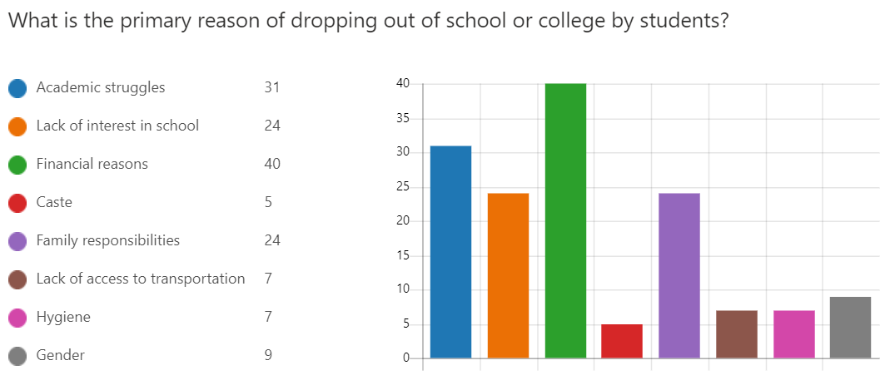

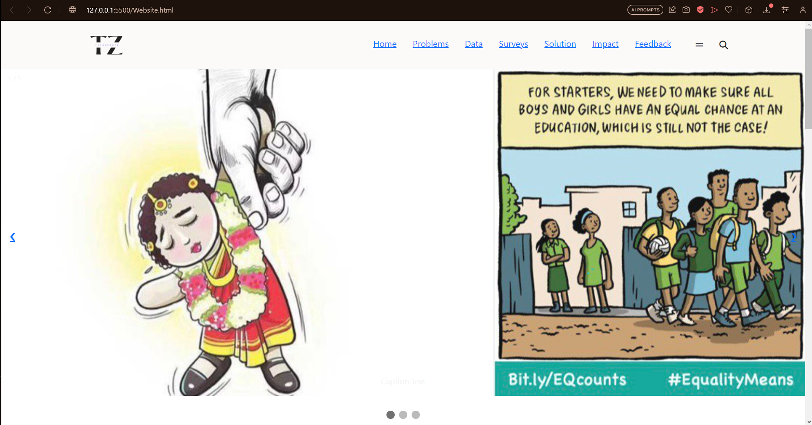
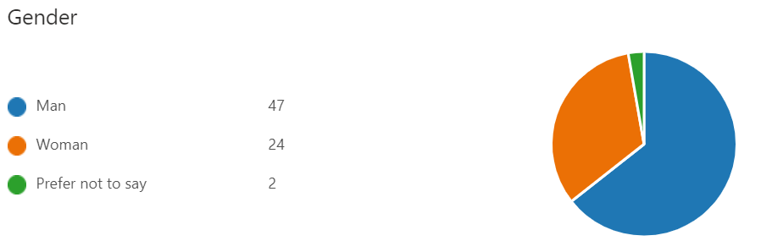
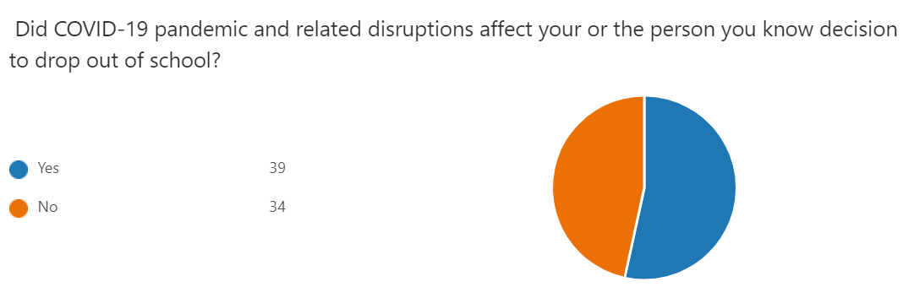
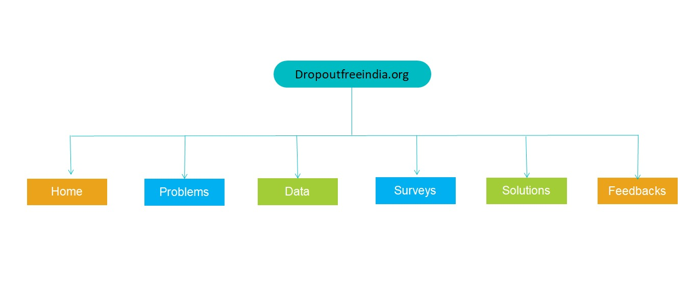
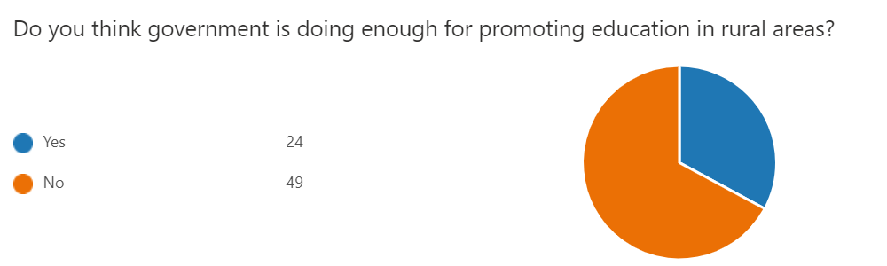
Design Prototype
Survey

Slide 4







THANK YOU !
AVINASH YADAV
TARUN DAGAR
HITESHA SAHANI
BTECH CSE
1ST YEAR
BTECH CSE
1ST YEAR
BTECH CSE
1ST YEAR
ARUN PANDEY
VISHAL
MANDEEP
BTECH CSE
1ST YEAR
BTECH CSE
1ST YEAR
BTECH CSE
1ST YEAR

